Slide 1


Slide 2


Slide 8
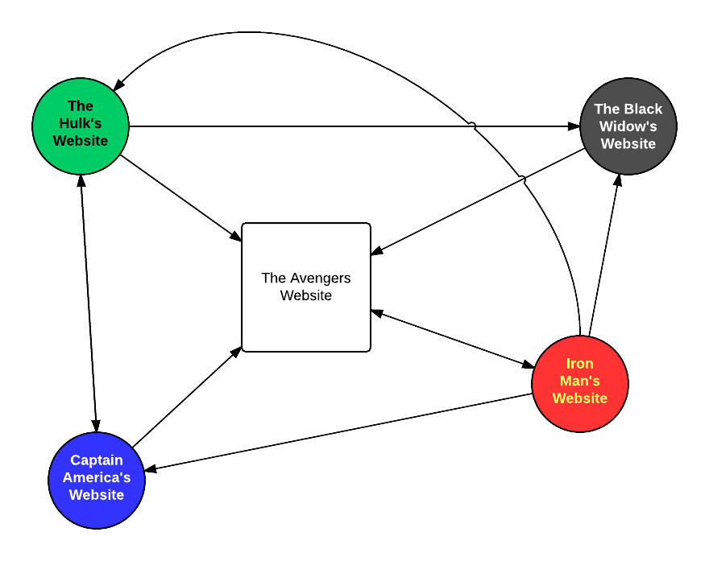
The Page Rank Algorithm

Slide 9


N = length(all_the_nodes) d = 0.85 foreach node: node.PR = 1 / N repeat: foreach node: total = 0 foreach incoming in node.incoming(): total += incoming.PR / length(incoming.outgoing()) node.PR = (1 - d) / N + d * total until convergence has been reached

Slide 10
N = length(all_the_nodes) d = 0.85 For each node in the graph, assign a value of 1/(number of nodes in the graph) Repeat until the numbers don’t change anymore (or don’t change by a determined amount)
For each node: Assign the total to be equal to 0 For each node with an incoming edge going towards the node in focus Add the (value of the incoming node)/(number of outgoing edges from this node) Set the next iteration node value to be (1 - d) / N + d * total
Update all current node values to their next iteration node values

Slide 11
PR(A) + PR(B) + PR(C) + … describe a probability space, and hence must sum to 1.0
N = length(all_the_nodes) d = 0.85 For each node in the graph, assign a value of 1/(number of nodes in the graph) Repeat until the numbers don’t change anymore (or don’t change by a determined amount)
For each node: Assign the total to be equal to 0 For each node with an incoming edge going towards the node in focus Add the (value of the incoming node)/(number of outgoing edges from this node) Set the next iteration node value to be (1 - d) / N + d * total
Update all current node values to their next iteration node values

Slide 13
0.2
0.2
0.2
0.2
0.2

Slide 14
0.15/5 + 0.85 * (0.2 / 2 + 0.2 / 4)
0.15/5 + 0.85 * (0.2 / 3 + 0.2 / 4)
0.15/5 + 0.85 * (0.2 / 2 + 0.2 / 4 + 0.2 / 3 + 0.2 / 1)
0.15/5 + 0.85 * (0.2 / 1)
0.15/5 + 0.85 * (0.2 / 3 + 0.2 / 4)

Slide 15
0.1575
0.13
0.38
0.2
0.13

Slide 16
0.15/5 + 0.85 * (0.13 / 2 + 0.2 / 4)
0.15/5 + 0.85 * (0.1575 / 3 + 0.2 / 4)
0.15/5 + 0.85 * (0.13 / 2 + 0.2 / 4 + 0.1575 / 3 + 0.13 / 1)
0.15/5 + 0.85 * (0.38 / 1)
0.15/5 + 0.85 * (0.1575 / 3 + 0.2 / 4)

Slide 17
0.128
0.117
0.283
0.353
0.117

Slide 18
N = length(all_the_nodes) d = 0.85 For each node in the graph, assign a value of 1/(number of nodes in the graph) Repeat until the numbers don’t change anymore (or don’t change by a determined amount)
For each node: Assign the total to be equal to 0 For each node with an incoming edge going towards the node in focus Add the (value of the incoming node)/(number of outgoing edges from this node) Set the next iteration node value to be (1 - d) / N + d * total
Update all next iteration node values to current node values

Slide 19
Damping factor
N = length(all_the_nodes) d = 0.85 For each node in the graph, assign a value of 1/(number of nodes in the graph) Repeat until the numbers don’t change anymore (or don’t change by a determined amount)
For each node: Assign the total to be equal to 0 For each node with an incoming edge going towards the node in focus Add the (value of the incoming node)/(number of outgoing edges from this node) Set the next iteration node value to be (1 - d) / N + d * total
Update all next iteration node values to current node values

Slide 20
Damping factor: probability that a random clicker will click on from a site
N = length(all_the_nodes) d = 0.85 For each node in the graph, assign a value of 1/(number of nodes in the graph) Repeat until the numbers don’t change anymore (or don’t change by a determined amount)
For each node: Assign the total to be equal to 0 For each node with an incoming edge going towards the node in focus Add the (value of the incoming node)/(number of outgoing edges from this node) Set the next iteration node value to be (1 - d) / N + d * total
Update all next iteration node values to current node values

Slide 21
N = length(all_the_nodes) d = 0.85 For each node in the graph, assign a value of 1/(number of nodes in the graph) Repeat until the numbers don’t change anymore (or don’t change by a determined amount)
For each node: Assign the total to be equal to 0 For each node with an incoming edge going towards the node in focus Add the (value of the incoming node)/(number of outgoing edges from this node) Set the next iteration node value to be (1 - d) / N + d * total
Update all next iteration node values to current node values

Slide 22
~ Probability that you will stay on this page
N = length(all_the_nodes) d = 0.85 For each node in the graph, assign a value of 1/(number of nodes in the graph) Repeat until the numbers don’t change anymore (or don’t change by a determined amount)
For each node: Assign the total to be equal to 0 For each node with an incoming edge going towards the node in focus Add the (value of the incoming node)/(number of outgoing edges from this node) Set the next iteration node value to be (1 - d) / N + d * total
Update all next iteration node values to current node values

Slide 23
N = length(all_the_nodes) d = 0.85 For each node in the graph, assign a value of 1/(number of nodes in the graph) Repeat until the numbers don’t change anymore (or don’t change by a determined amount)
For each node: Assign the total to be equal to 0 For each node with an incoming edge going towards the node in focus Add the (value of the incoming node)/(number of outgoing edges from this node) Set the next iteration node value to be (1 - d) / N + d * total
Update all next iteration node values to current node values

Slide 24
~ Probability that you got here from another page
N = length(all_the_nodes) d = 0.85 For each node in the graph, assign a value of 1/(number of nodes in the graph) Repeat until the numbers don’t change anymore (or don’t change by a determined amount) For each node: Assign the total to be equal to 0 For each node with an incoming edge going towards the node in focus Add the (value of the incoming node)/(number of outgoing edges from this node) Change the value of the node to be (1 - d) / N + d * total

